Slide 1
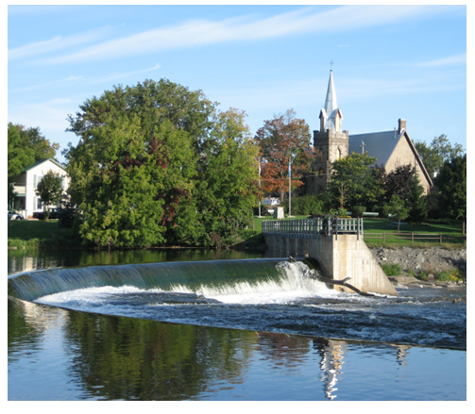

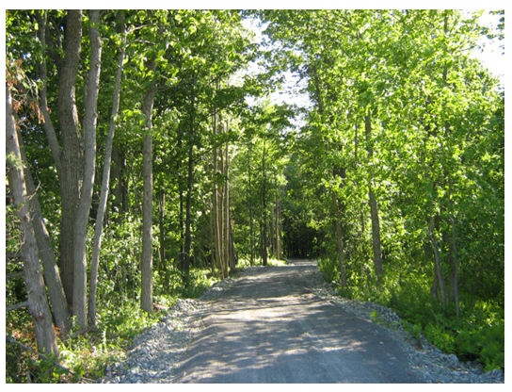
Presented by:
David Somppi, Steering Committee Chair
Jan 2024

Slide 2

WHAT IS PLANET YOUTH
Planet Youth (PY) is a population-wide primary prevention process designed to have a long-term impact in communities by reducing youth substance use.
Instead of discussing the facts and faults of alcohol, tobacco, and other drug use with adolescents, Planet Youth treats society as “the patient.”

Slide 3
The Proven Icelandic prevention model
Time spent with parents
Support
Monitoring
Control
Family
factors
Peer group effect
School
Organized activities
vs.
unorganized
Individual
Positive and negative effects.
How we as parents approach the peer group
Staying outside late
Hanging out in malls
Extracurricular
activities
Inside and outside of school, at home, bullying e.t.c.
More than 100 peer reviewed publications available at https://planetyouth.org/the-method/publications/

Slide 4
The Planet Youth Guidance Program:
The 10 core steps of the Icelandic Prevention Model
First Canadian
Survey Spring 2022
Step 1
Local Coalition Identification, Development, and Capacity Building
Step 2
Local Funding Identification,
Development, and Capacity Building
Step 3
Pre–Data Collection
Planning and Community Engagement
Step 4
Data Collection and Processing, Including Data Driven Diagnostics
Step 5
Enhancing Community Participation
and Engagement
Step 6
Dissemination of Findings
Step 7
Community Goal-Setting and
Other Organized Responses to
the Findings
Step 8
Policy and Practice Alignment
Step 9
Child and Adolescent Immersion in Primary Prevention Environments, Activities, and Messages
Step 10
Repeat Steps
1-9 every 2 years
Results of June 1 workshop on next page
Planning second survey Spring 2024
Notes:
4

Slide 5
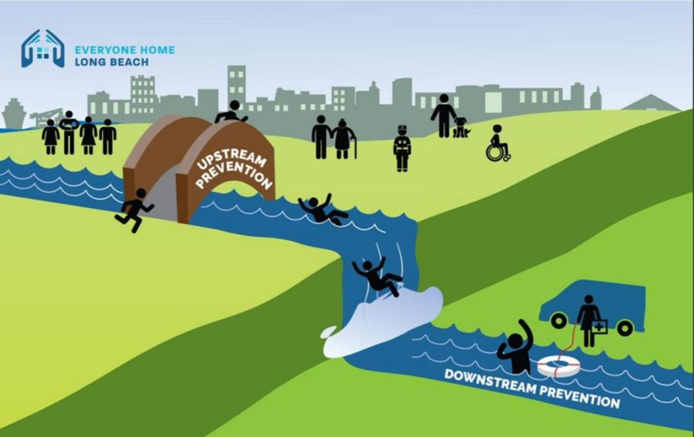
Upstream Goals Decided at June 1 Community Workshop
Outcomes
Reduced Substance Use
Better Mental Health
Better Physical Health
Goals
Better Sleep
Feeling Safe
From Long Beach Health Dept presentation to Long Beach City Council on April 20/21.
Notes:
If we prevent people from falling in the water ……. They won’t go over the waterfall

Slide 6
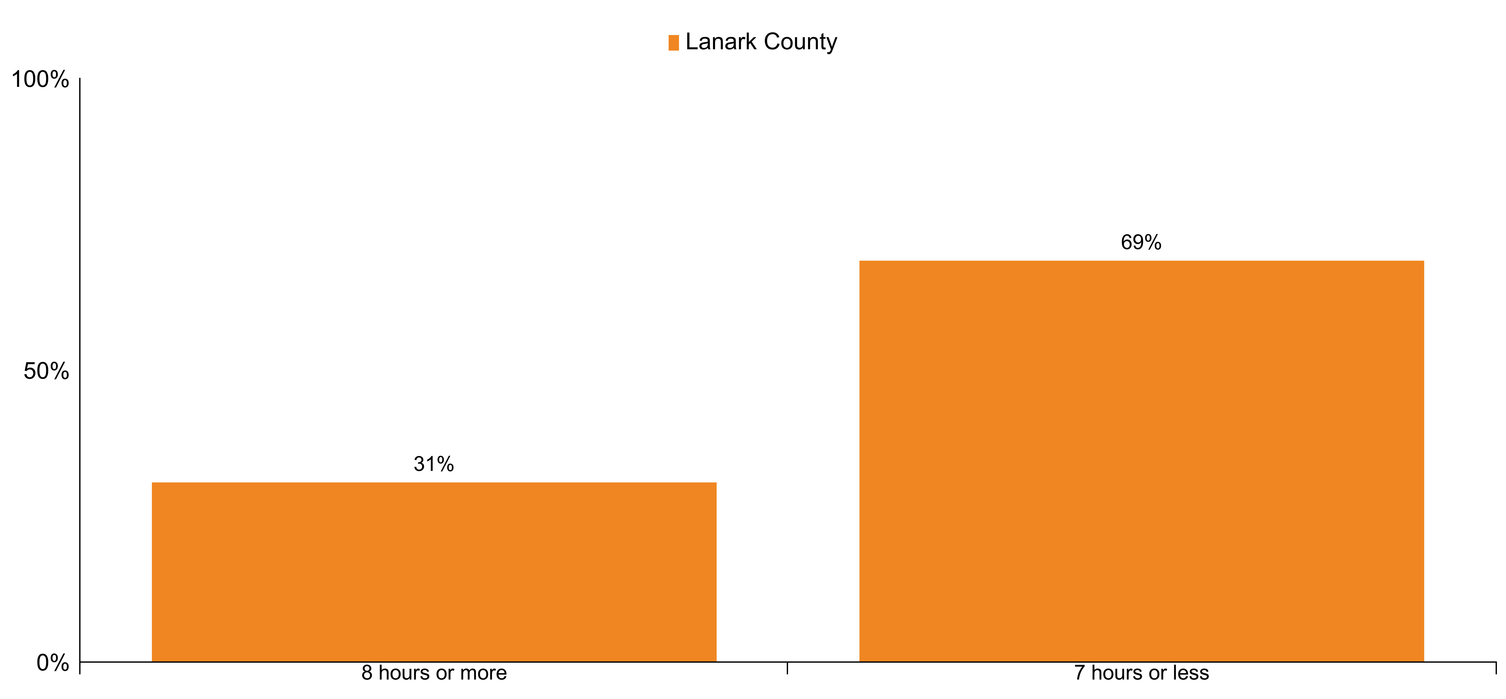
Proportion of adolescents in Lanark County who report sleeping on average 8 hours or more a night, or 7 hours or less a night
35% of students were absent from school because they were too tired”
UCDSB “We All Belong JK-12 Student Survey” Apr 23

Slide 7
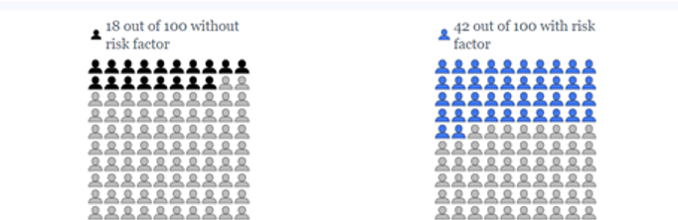
Mental Health, Resilience & Sleep
I am happy - 7 hours or less of sleep
I am happy - 8 hours or more of sleep

Slide 8
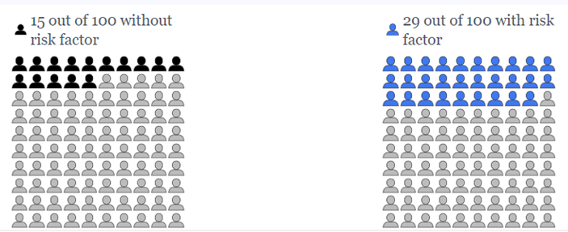
Mental Health, Resilience & Sleep
I used cannabis during last 30 days 8 hours or more of sleep
I used cannabis during last 30 days 7 hours or less of sleep

Slide 9
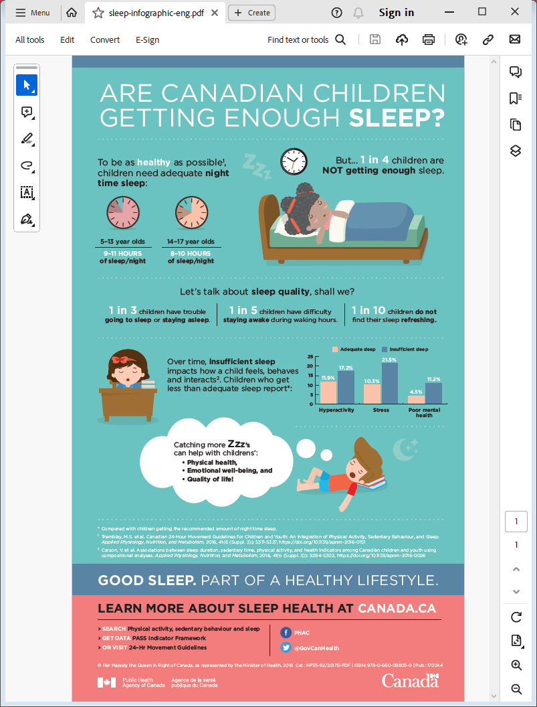
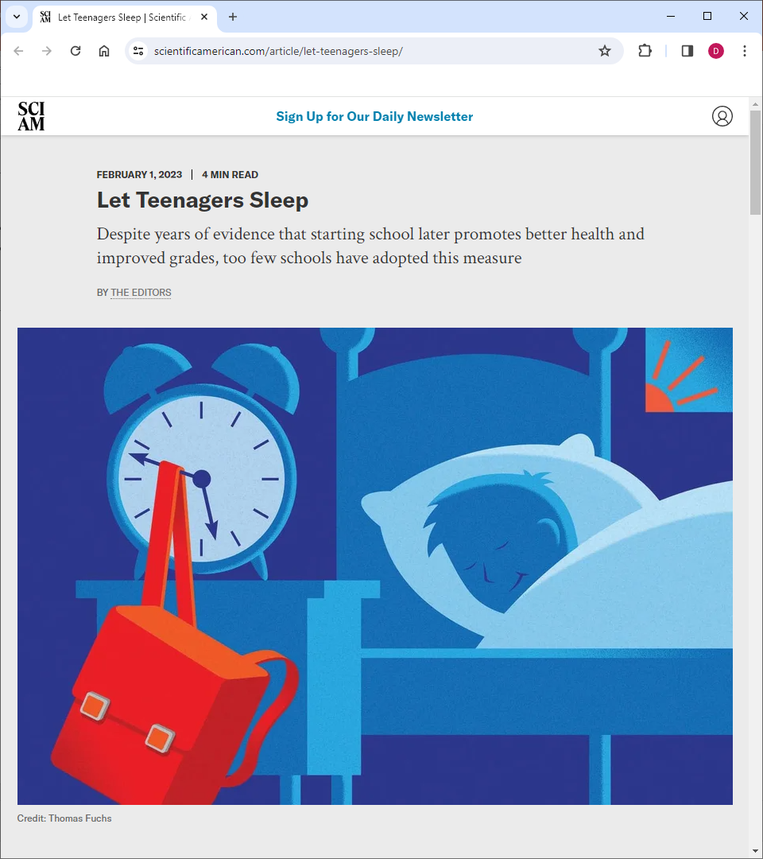
Insufficient sleep is a significant risk factor
Review of the science provided in UCDSB Consultation on Adjusting Bell Times to promote improved sleep
https://youtu.be/Zl3y77qAxb4

Slide 10
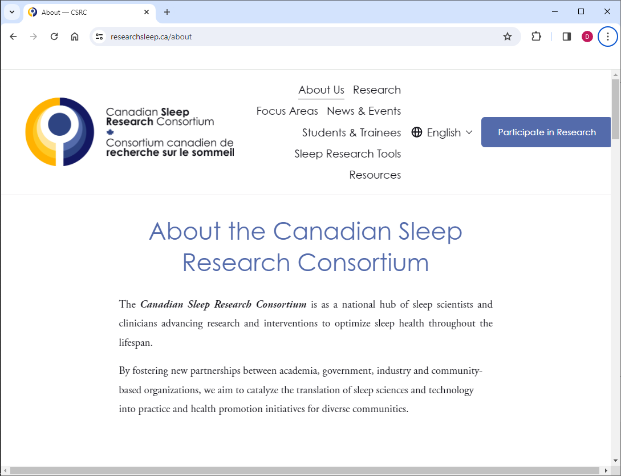
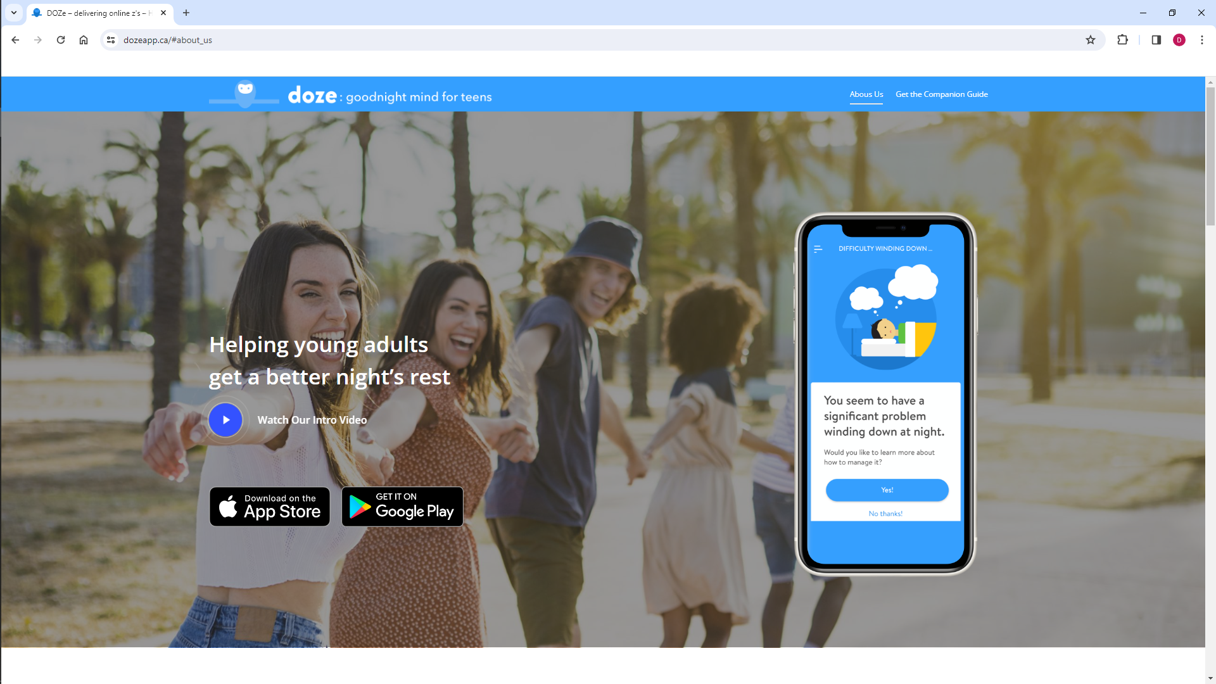
Increase Awareness of Sleep’s Importance
Developing 2024 plan now.
Please let me know if you are interested in helping out.
Opportunity to collaborate with newly formed Canadian Sleep Research Consortium

Slide 11

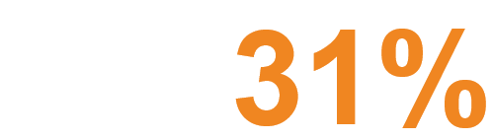
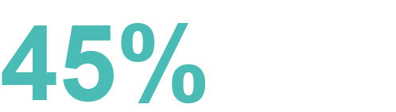
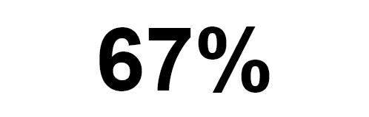


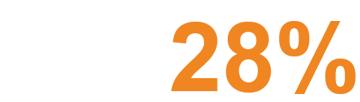
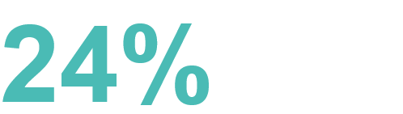
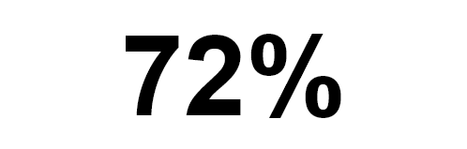
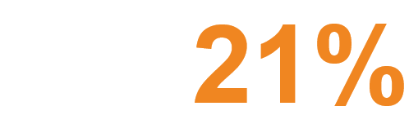

School- Key Findings
“7 in 10 students feel safe in various locations throughout the school”
UCDSB “We All Belong JK-12 Student Survey” Apr 23
Girls
Boys
Bored
Are often or always
bored with the studies
Bored
Are often or always
bored with the studies
Feel safe at school
Feel Bad
Often or always feel
bad at school
Feel Bad
Often or always feel
bad at school
Want to change schools
Skipped School
Skipped school once or more
in the past month
Skipped School
Skipped school once or more
in the past month
Get along with the teachers
Reports available at https://planetyouthlanark.ca/survey-findings/

Slide 12

How are we involving youth voices?
Asset Mapping in early 2022 with Student’s Commission
Began youth consultation process October of 2022 - ongoing
All Youth Centres completed 1st round
Other Youth Serving Organization Youth groups (Open Doors)
Local high schools (PDCI & CPHS)
August 2023 Youth Summit
Report available from facilitators soon
Key message is we need to listen to youth
2024 - 2027
Developing plan for 2 summits per year
Establishing Youth Advisory Committee
To help shape how the initiatives will be implemented
“With Us not For Us”
Leadership by Rebecca Shams, LLGHU Health Promoter
Developing Lanark County wide 3 year youth engagement plan
Notes:
We have consulted with over 300 youth in Lanark County since October. Ranging in age from 10-18.
Community: 100
Schools: 200+

Slide 13
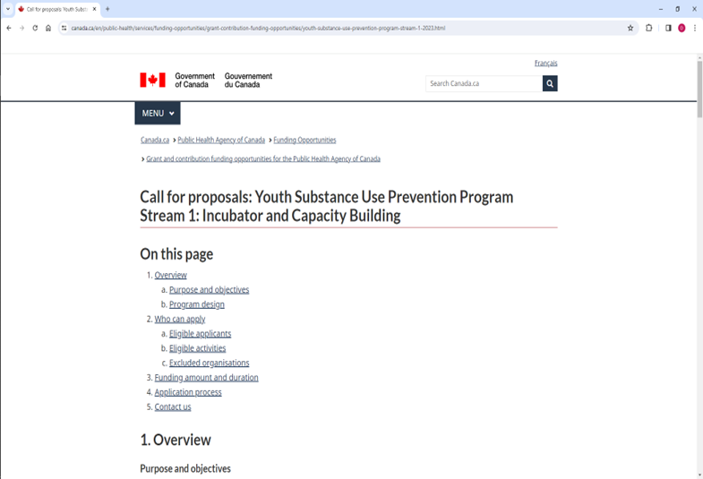
Funding Opportunity via PHAC
Stream 2: Implementation Research
This second Stream of funding is not part of this solicitation. It will support eligible recipients to identify, test and rigorously evaluate an intervention in accordance with the core steps of the IPM.
Maximum amount of $250,000 of funding per year for up to 3 years
Applications by invitation only in a separate CFP, planned for Spring 2024
Recipients must have completed steps 1 to 3 of the IPM prior to the project start date
Funding will support the recipient to deliver and evaluate interventions that have been identified through real-time local data and engagement sessions
Targeted solicitation and intake for Stream 2 will happen in Spring 2024 and Spring 2025
As part of Stream 2, eligible recipients will also be required to work with a researcher to conduct Population Health Implementation research to measure the impact of implementing the IPM in their community
Planet Youth Lanark County anticipates being invited to apply for Stream 2 funding in Spring 2024
A strong evidence informed/community based intervention/action plan is required
Everyone is welcome/encouraged to join in developing the plan

Slide 14
www.planetyouthlanark.ca
info@planetyouthlanark.ca
Society Evolves At The Speed Of Relationships
Relationships Are Built At The Speed of Trust

