Slide 1
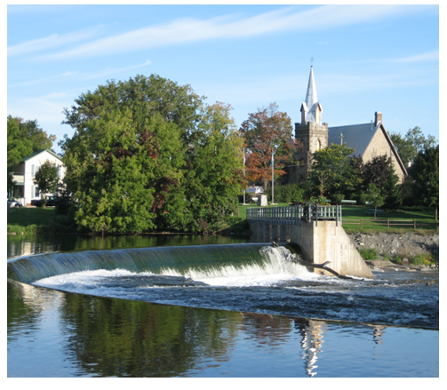

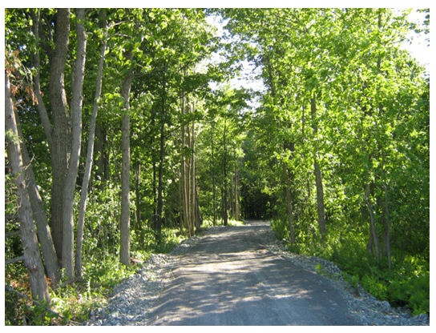
Hearing Unheard Moments
Feb 12, 2026
Joey Graff, Co-Ordinator and Implementation Team Member
David Somppi, Steering Committee Chair

Slide 2
Summary
Opportunity to join a national coalition striving to interrupt polarizing, anger-fuelled cultures and echo-chambers.
Provides access to HUM resources, core messages, and programming offered by a growing number of partners and communities.
HUM is facilitated by the Students Commission of Canada and funded by the federal government 🡺 membership is free
Our commitment would be to share our learnings with other communities
Recommendation: The Community Safety Working Group meet with SCC’s Christian Everall to learn more about the coalition and the work underway in Prince Edward County

Slide 3
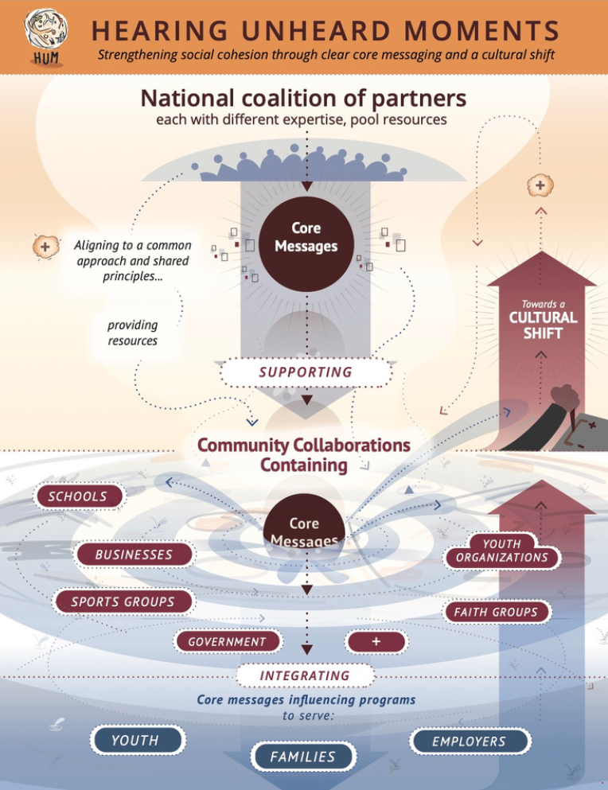

Slide 4

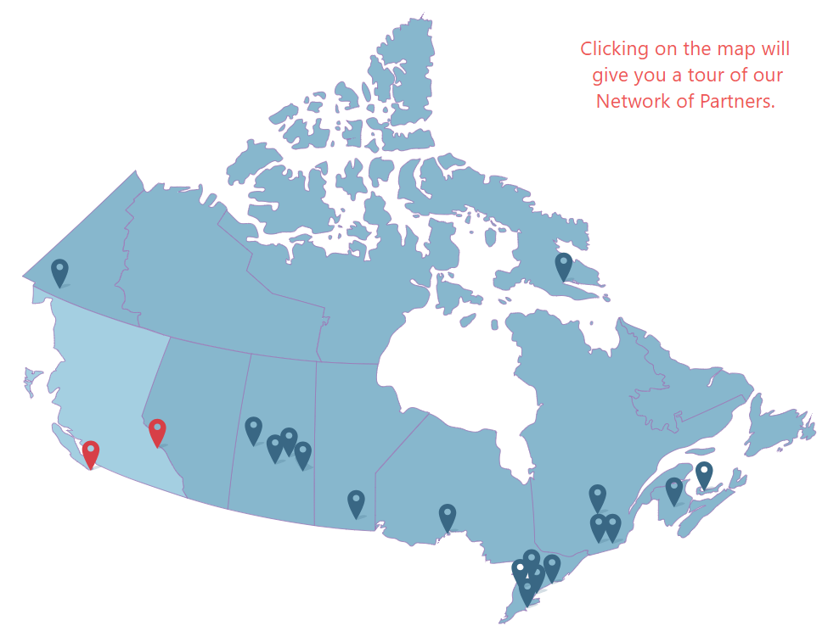
The Students Commission of Canada was formed in 1991
Purpose: The SCC is a charitable organization that purposefully works with others to ensure that young people are valued, heard and their ideas for improving themselves, the lives of their peers and communities are put into action.
Our desired outcome: A world where all young people transition positively into a successful adulthood.Previous collaborations with Students Commission of Canada include a 2022 Asset Mapping
SCC co-ordinates three national networks: Youth/Adult Partnership, Centre of Excellence for Youth Engagement, and Sharing the Stories, plus several local and regional networks.
Has a toolkit available to support evaluation of our work

Slide 5


Slide 6
Shared goal
Provide healthier, safer spaces off-line and on-line for all children and youth to grow and thrive;
Spaces to be heard, explore differences
and still belong
Spaces to talk, process, and act on challenges youth face
Spaces to voice grievances and concerns and prevent them from turning into hate and violence.

Slide 7
Goals for all HUM communities
Infusing HUM key messages into existing youth programming
Building capacity of adults supporting youth, including skill sets for practising key messages themselves
Identifying, shifting, building collaborations that synergize efforts to shift culture

Slide 8
Communities in Action
Local collaborations and events are underway in Prince Edward County, Golden, Toronto, Vancouver, Edmonton, Kitchener-Waterloo, Hay River, Prince Albert, Saskatoon, Winnipeg, Montreal, Eastern Townships, Halifax, and Virtual.

Slide 9


Slide 10
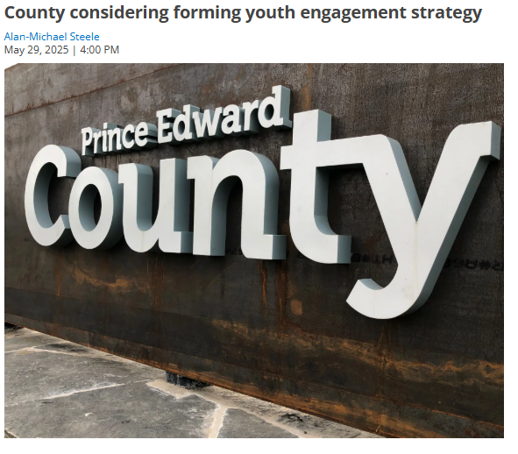
May 29, 2025 | 4:00 PM
During Thursday’s Committee of the Whole meeting, the committee voted to investigate creating a youth engagement strategy for the municipality.
As part of the meeting, the council heard a deputation from Janet MacGillivray and Christian Everall, of the Greater Than County Youth Collective.
The pair spoke about a number of issues facing youth in Prince Edward County, and presented the findings of survey work they had done to understand the concerns of those aged 30 and below.
The report mentioned that many youth the group had surveyed feel marginalized in the community, with their voices not being heard by the municipal government, and their needs not being addressed.
In addition, that age group faced challenges with participating in local government. Those challenges included geographic isolation in rural areas, financial challenges, and time constraints as working multiple jobs left them little time for other pursuits.
The group presented several recommendations to council, which included increasing direct outreach to youth and ensuring youth representation on municipal committees.
After considering the presentation, Councillor Englesdorfer proposed having municipal staff investigate creating a youth engagement plan, to allow the municipality to directly engage with youth and address their concerns.
“There’s a whole group of young folks like yourselves coming out and getting involved, and I think that’s great. So I think we need to listen and engage with your group,” said Councillor Englesdorfer.
The motion was passed with no debate.
County considering forming youth engagement strategy | Quinte News

Slide 11
HUM can build upon existing work in Lanark County
A benefit of engaging with Hearing Unheard Moments, is the
ability to utilize information that is currently being gathered
through Planet Youth. By leveraging the results of the ongoing
RES360 Rapid Assessment and the Planet Youth School Surveys,
HUM can tailor to the needs of the community.
HUM will utilize the information that Lanark County has already
gathered, to move towards taking action faster.

Slide 12
Recommendation
The Community Safety Working Group meet with SCC’s Christian Everall to:
Learn more about HUM and the national coalition
Prince Edward County’s experience implementing HUM
Lanark County based youth serving organizations take advantage of resources and training that are available through the work of the HUM coalition

