Slide 1

Local Immigration Partnership – Lanark & Renfrew

Slide 2
Local Immigration Partnership – Background
  Local Immigration Partnerships (LIP) are funded by Immigration, Refugees and Citizenship Canada (IRCC) and support communities in bringing together service providers, settlement agencies, community groups, employers and other key municipal organizations to create a welcoming and inclusive community for newcomers.
  Formed locally in 2011
  Contract held by Algonquin College – Pembroke Campus
  One of 87 LIPs/RIFs/ZIPs across Canada
www.liplanarkrenfrew.ca

Slide 3



What Does LIP – Lanark & Renfrew do?
  Primary Services
    Research
    Knowledge sharing
    Facilitation
www.liplanarkrenfrew.ca
Notes:
At the heart of Local Immigration Partnership (LIP) and the work we do is a commitment to research, knowledge sharing, and facilitation.
Our research initiatives, guided by key stakeholders in Lanark and Renfrew, aim to uncover the specific challenges that newcomers face in fully engaging with community life. This invaluable insight not only highlights obstacles but also identifies opportunities that facilitate the successful settlement of newcomers in our rural areas.
Knowledge sharing is equally vital to our work. As leaders, you understand that the pursuit of knowledge is limitless. At LIP, we embody this through our dynamic newcomer and community resource hubs which can be freely accessed through our website. This evolving component of our website is filled with essential information to support newcomers, community members, and organizations in accessing local resources. We also host various community events that foster meaningful connections among individuals.
Facilitation is another component of our work. We provide opportunities for personal and professional development in diversity, equity, and inclusion, empowering local employers and organizations to better understand and engage with the diverse array of clients and staff they serve.
While we do not offer formal settlement services, think of LIP as a bridge connecting communities, organizations, and newcomers. We are a collaborative network and resource hub, dedicated to offering support wherever possible.

Slide 4
Our Major Projects:
Culture Connect
Intercultural Development Workshops – Including IDI®
The Lanark & Renfrew Counties Welcoming Network
Website – Community Navigation
RSIFEO x LIP – Connecting Francophone Employers
Custom Resources
Municipal Inclusion Charter Project
www.liplanarkrenfrew.ca

Slide 5
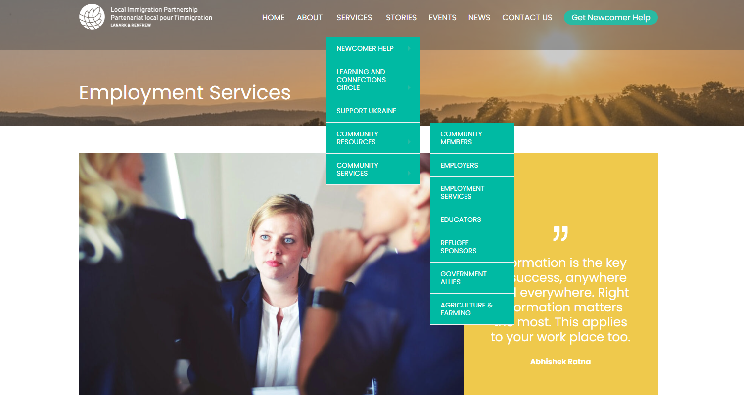
Employer/Community Supports
Networking opportunities in the Ottawa Valley
Job searching and employment help. Getting your education credentials assessed
Unconscious Biases and Overcoming them
Developing Inclusive Workplaces
Inclusive Recruitment
Finding Newcomer Talent
Temporary Foreign Worker Report
How to connect with and utilize services such as Service Ontario
Much more!
Notes:
After listening to Allison’s presentation and better understanding the specifics on what the labour market looks like in Lanark & Renfrew, we know that there are significant gaps across multiple industries and so many employers are facing difficulties in attracting and retaining good staff. A good portion of the resources, information, and supports in this area of our website are targeted towards you, the organizations of Lanark & Renfrew, who are looking to address their labour market gaps, help out a newcomer, or just diversify their workforce through connecting with and hiring newcomers to the area.

Slide 6
Contact:
You can reach out to the LIP – Lanark & Renfrew team via phone or email.
Email: Localimmigrationpartnership@algonquincollege.com
Phone: 613-735-4308 ext. 2878
Notes:
Once again, the mission of LIP – Lanark & Renfrew is to strengthen local communities by actively engaging newcomers, immigrants, refugees, and international students who reside, work, study, and thrive in Lanark and Renfrew County.

