Slide 1
Hearing Unheard Moments
“Creating safer spaces for dialogue over difference”
A Student’s Commission of Canada Initiative

Slide 2




4 Core Messages

Slide 3
Upstream prevention work in the community around social cohesion and violence prevention
Access to FREE trainings that can support the safety working group’s efforts to create safer spaces in our community
This work can use existing data and build on our current work and strong community connections.
What is H.U.M.?
Notes:
5 mins up to now

Slide 4

Notes:
20 mins – Joey leads

Slide 5
Data Reveal & Break-time
During the break, have a closer look at the data
Does your knowledge of the community validate this?
Were there any surprises?
Notes:
15 min break:
Spend 3-5 minutes after break sharing on these questions

Slide 6
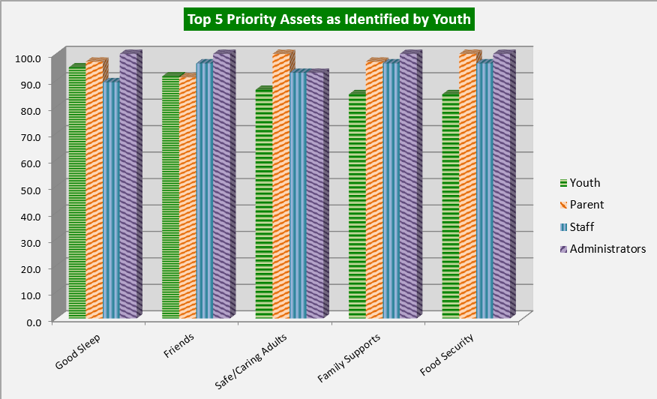

Slide 7
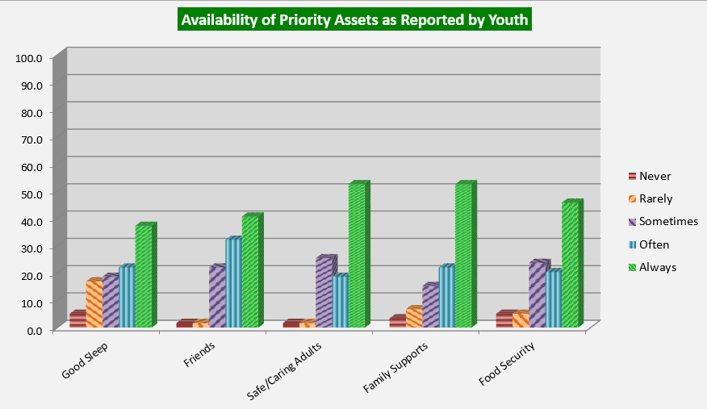

Slide 8
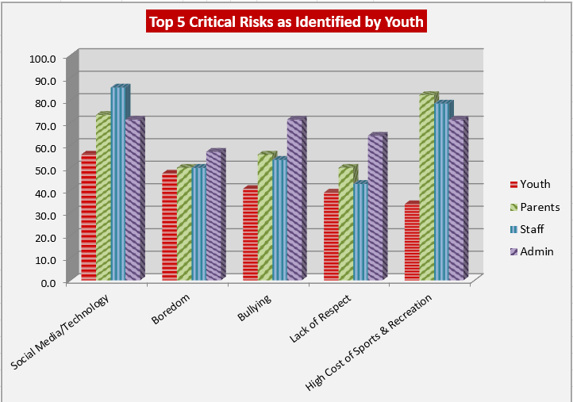

Slide 9
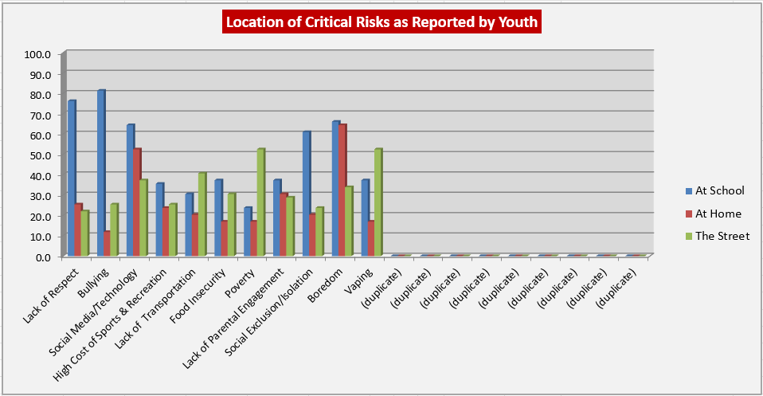

Slide 10
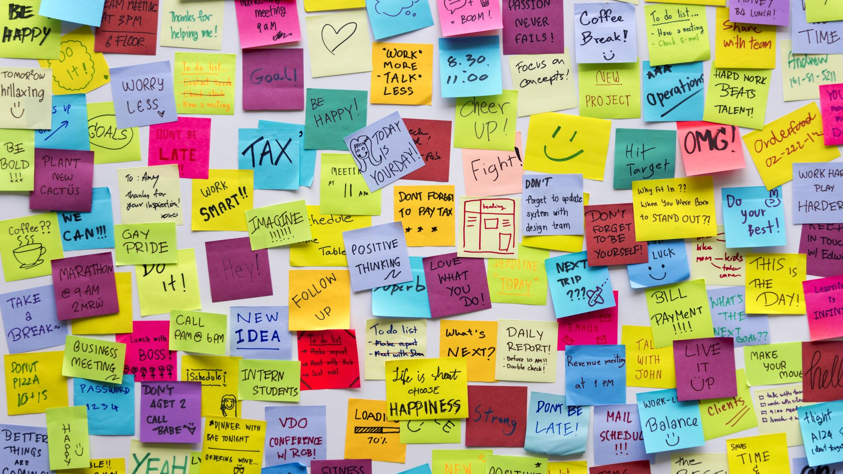
Brainstorming!
How can we leverage our strengths to address the risks?
WHAT are we already doing around upstream prevention for this?
Notes:
10:35 15 minutes – call out popcorn style and/or use stickies or cue cards

Slide 11
What’s Available from H.U.M.?
Menu of trainings on the wall
Dotmocracy - vote for what you think is most important - you have 5 dots each – use them wisely☺
Stickies for new or other ideas
Notes:
20-25 minutes
I can have these written up on a flip chart page too for the dotmocracy
Dotmocracy with sticky notes for ‘other’
Brainstorm potential audiences for these trainings – this will continue in the Safety Working Group including how to best promote within those audiences.

Slide 12
Next Steps:
Safety working group to plan trainings and/or resource sharing
Are there any steps our individual organizations can take in the meantime?
Youth data validation and planning
can be parallel and complimentary (YCs and schools)
Notes:
2 mins

Slide 13

Comments, Suggestions, Questions?
Notes:
Time?

