Slide 1


Lanark County Child and Youth Services Collaborative
Rideau Eco-Literacy Center for Children Presentation
(requires an internet connection for video)

Slide 2

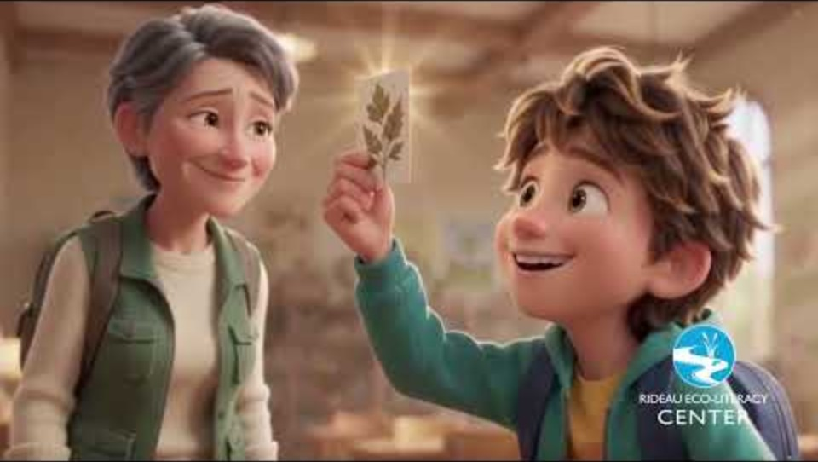
Who We Are
Video goes here:
https://youtu.be/-sPhOPDXLrA

Slide 3
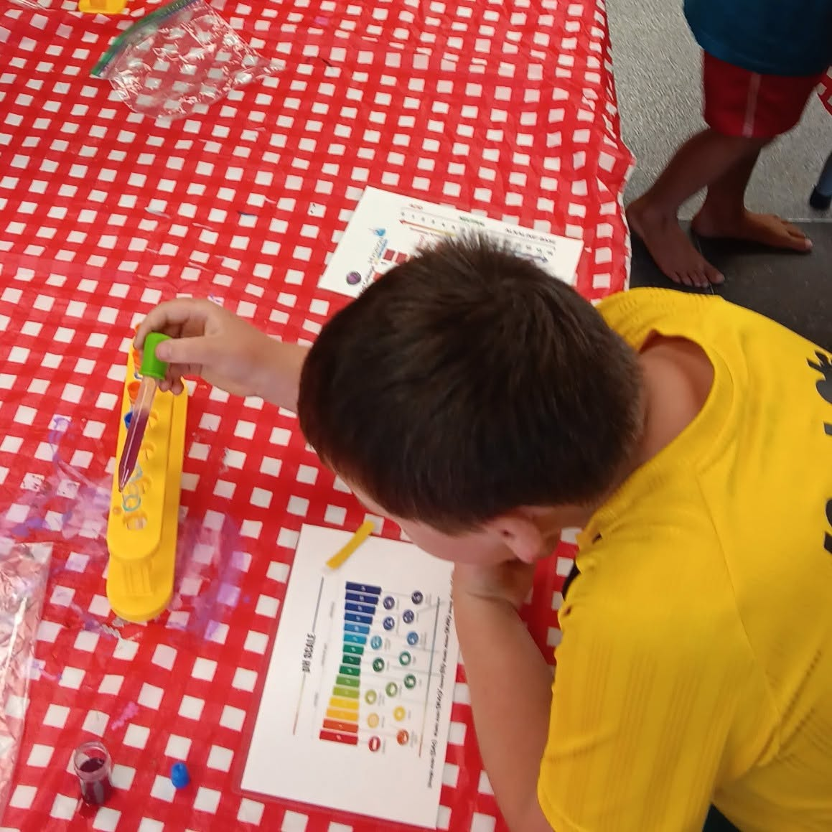

We build:
Confidence
Knowledge and Competency
Interpersonal and Communication Skills
Leadership and Self-Advocacy Abilities
Passion for Investigation and Exploration
The Environmental Stewards of Tomorrow
Notes:
Tina

Slide 4

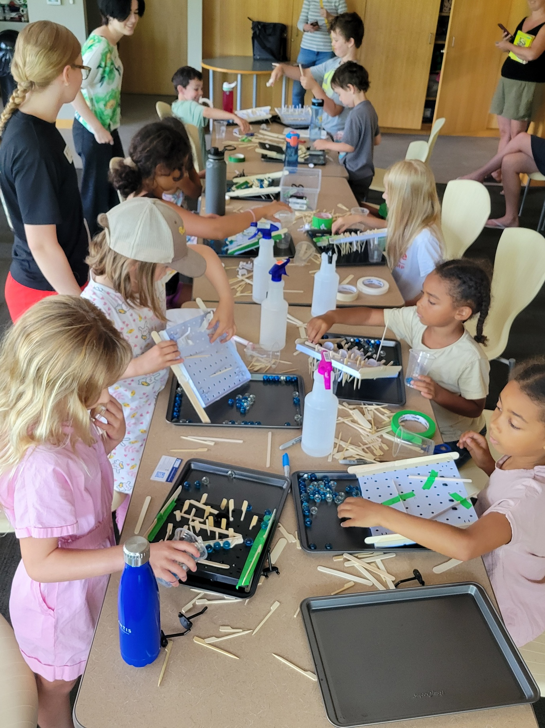
Metrics from Program
(March 2025 – August 2026)
17 Workshop Topics:
  (Potions and Lotions, Wetlands, Terrariums, Build a Bird, Molecules, Water Quality, Canoe Adventures, etc.…)
6 Public Libraries:
  (Merrickville, Perth and District, Smiths Falls, Rideau Lakes,
  North Grenville and Westport)
  For a total of:
91 Rideau Eco-Literacy Events
  Provided free of charge to …
Notes:
Tina

Slide 5
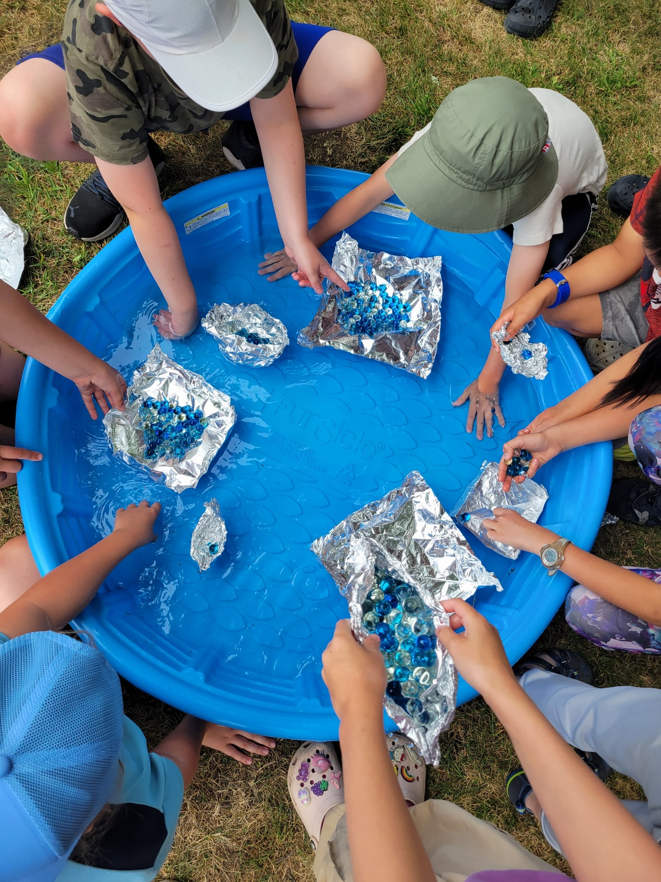
  Metrics 2025
  (workshops were monthly March- June & weekly July- August at each library- 59 events )
Provided free of charge to
591 children
  ages 5-12
Plus 174 “hangers-on”
  (siblings, parents and grandparents)
For a total of 765 attendees
Notes:
Tina

Slide 6
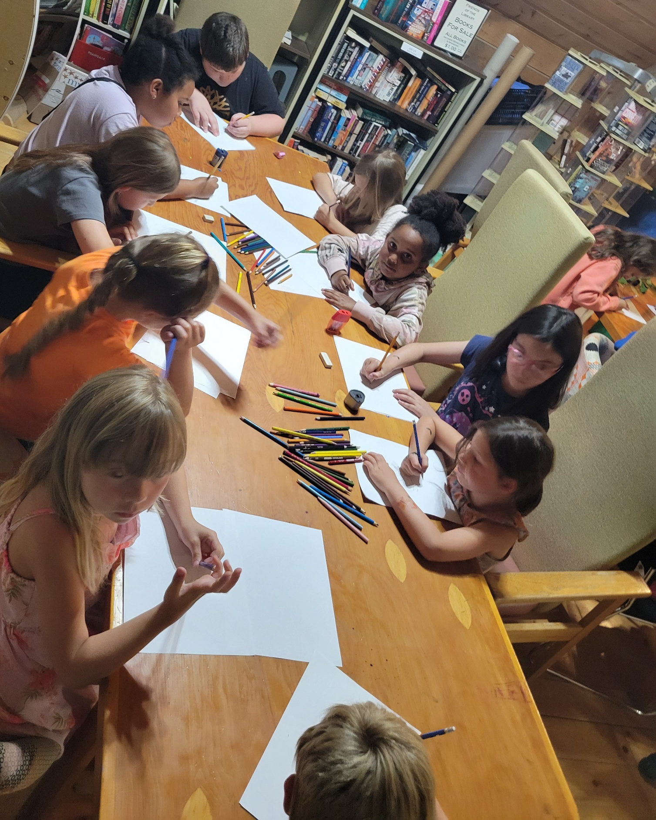
  Metrics 2026
  (workshops were bi-Weekly July- August at each library- Total of 32 events)
So far, this year, provided free of charge to:
356 children
  ages 5-12
Plus 87 “hangers-on”
  (siblings, parents and grandparents)
443 For a total of attendees
…with about 20 more workshops to come in 2026
Notes:
Tina

Slide 7
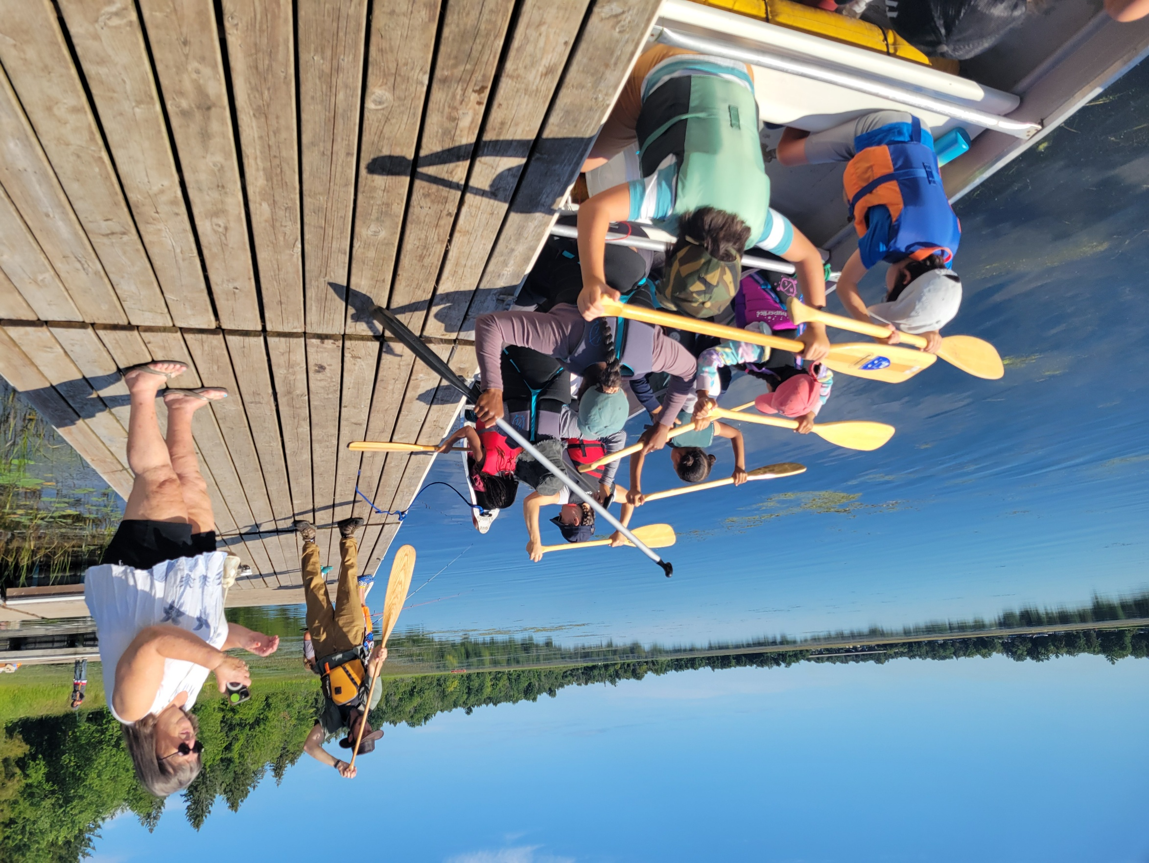
  Total Metrics (since March 2025)
The program has been provided free of charge to
947 children
  ages 5-12
Plus 261 “hangers-on”
  (siblings, parents and grandparents)
For a total of 1,208 attendees
…so far…
Notes:
Tina

Slide 8

End of February last year we learned
(at a Chinese New Year celebration in fact ...)
Notes:
Richard

Slide 9
‘Growing’
We are starting a program with Middle School Students through Rideau Lakes Library
Developing a sustainable year-round schedule
Continuing to seek funding
Enlarging our circle of families and participants, volunteers and supporters (for example: The Rotary Club of Smiths Falls)
What’s Next for Us?
Notes:
Richard or Andre

Slide 10
What’s Next for Us?
Plus:
Making the programming more robust with:
More outings/ outdoor adventures
Collaborative initiatives among the libraries and with other organizations
Notes:
Richard or Andre

Slide 11



Let’s Create Something Amazing Together

Slide 12
How
Can
You
Help?
Connections and Networking
Invite us to meet your Membership/
Colleagues/ Clients (if appropriate)
Create a liaison/ contact person for us with your organization
Send along funding opportunities
Share resources and best practices

Slide 13
We can
How
Can We
Help
You ?
Do all the stuff from the last slide for you
Share your initiatives on our Social Media
Attend/ support your events
Participate if appropriate: i.e. doing workshops or providing animation for children & youth

Slide 14

Thank You
www.rideauecoliteracy.com
info@rideauecoliteracy.com
Tina Bye- 450.374.1672 (Rideau Eco-Literacy Director)

